Slide 1
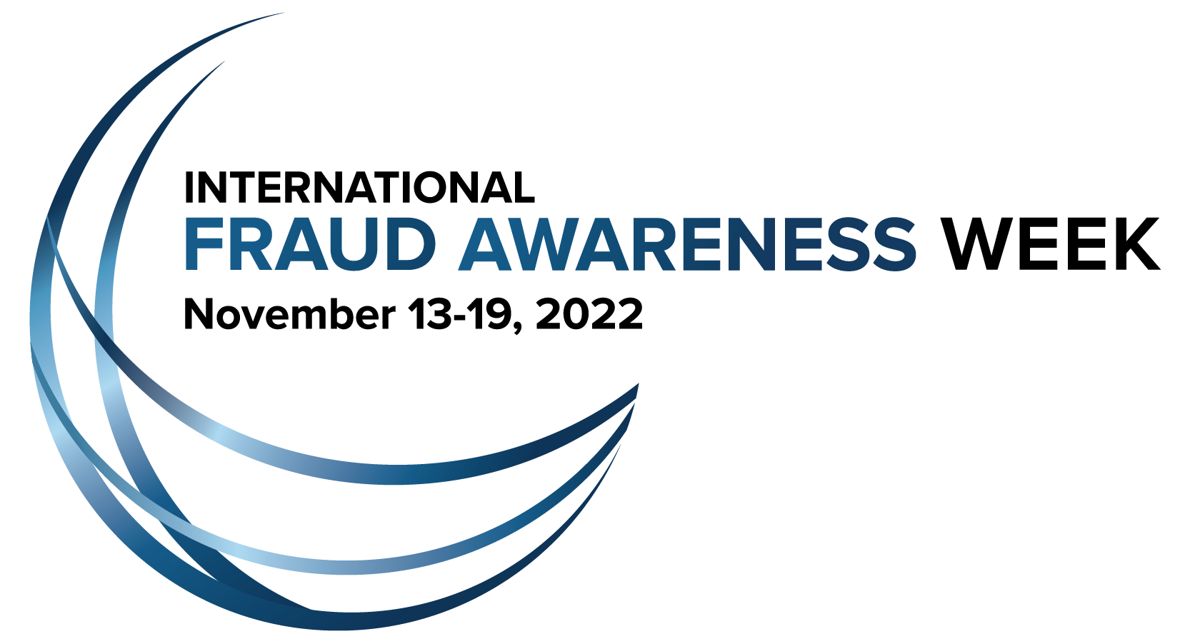
International Fraud Awareness Week 2022 Fraud Jeopardy

Slide 2
Welcome to International Fraud Awareness Week 2022 Jeopardy!
On the following slide there is a game board with six categories that have five questions each. Players should select the category and point value they want to answer. When you click on the point value of that tile, you’ll be taken to the question slide. If you click to the next slide, it will take you to the answer and a link to go back to the main scoreboard.
Good luck and have fun!

Slide 3
Categories
Fraud Schemes
Detection
Investigation
Psychology and the Red Flags of Fraud
Anti-Fraud Controls and Prevention
Fraud in History and Pop Culture
$200
$200
$200
$200
$200
$200
$400
$400
$400
$400
$400
$400
$600
$600
$600
$600
$600
$600
$800
$800
$800
$800
$800
$800
$1000
$1000
$1000
$1000
$1000
$1000

Slide 4
THIS TYPE OF FRAUD SCHEME INVOLVES LAYERING, PLACEMENT AND INTEGRATION.
Fraud Schemes· $200

Slide 5
WHAT IS MONEY LAUNDERING?
Fraud Schemes· $200

Slide 6
OF THE THREE PRIMARY CATEGORIES OF OCCUPATIONAL FRAUD OF THE FRAUD TREE, THESE SCHEMES TEND TO CAUSE THE LARGEST LOSSES.
Fraud Schemes· $400

Slide 7
WHAT IS FINANCIAL STATEMENT FRAUD?
Fraud Schemes· $400

Slide 8
THIS TYPE OF SCHEME IS ILLEGAL IF IT EMPHASIZES RECRUITMENT OVER PRODUCT SALES AND PROMISES THAT MONEY CAN ONLY BE MADE THROUGH RECRUITMENT.
Fraud Schemes· $600

Slide 9
WHAT IS A PYRAMID SCHEME?
Fraud Schemes· $600

Slide 10
THIS TYPE OF FRAUD TARGETS GROUPS OF PEOPLE WHO HAVE SOME SOCIAL CONNECTION, LIKE A RELIGION OR CULTURAL BACKGROUND.
Fraud Schemes· $800

Slide 11
WHAT IS AFFINITY FRAUD?
Fraud Schemes· $800

Slide 12
THIS SCHEME, ALSO KNOWN AS OFF-BOOK FRAUD, OCCURS WHEN CASH IS REMOVED FROM A VICTIM ENTITY PRIOR TO ITS ENTRY IN AN ACCOUNTING SYSTEM.
Fraud Schemes· $1000

Slide 13
WHAT IS SKIMMING?
Fraud Schemes· $1000

Slide 14
ACCORDING TO THE ACFE’S OCCUPATIONAL FRAUD 2022: A REPORT TO THE NATIONS, THIS WAS THE MOST COMMON WAY FRAUD WAS DETECTED.
Detection· $200

Slide 15
WHAT ARE TIPS?
Detection· $200

Slide 16
ACCORDING TO THE ACFE’S OCCUPATIONAL FRAUD 2022: A REPORT TO THE NATIONS, MEDIAN LOSSES NEARLY DOUBLED IN ORGANIZATIONS THAT DID NOT HAVE THIS DETECTION METHOD ESTABLISHED.
Detection· $400

Slide 17
WHAT ARE HOTLINES?
Detection· $400

Slide 18
IF THE DISTRIBUTION OF DIGITS IN MULTI-DIGIT NATURAL NUMBERS DO NOT FOLLOW A PREDICTABLE PATTERN, IT MAY BE AN INDICATOR OF FRAUD SINCE IT VIOLATES THIS LAW.
Detection· $600

Slide 19
WHAT IS BENFORD'S LAW?
Detection· $600

Slide 20
THIS IS THE TOTALITY OF CIRCUMSTANCES THAT WOULD LEAD A REASONABLE, PROFESSIONALLY TRAINED AND PRUDENT INDIVIDUAL TO BELIEVE THAT A FRAUD HAS OCCURRED, IS OCCURRING OR WILL OCCUR.
Detection· $800

Slide 21
WHAT IS PREDICATION?
Detection· $800

Slide 22
ACCORDING TO THE ACFE’S OCCUPATIONAL FRAUD 2022: A REPORT TO THE NATIONS, THIS PASSIVE METHOD OF FRAUD DETECTION LED TO THE HIGHEST MEDIAN LOSS, OF FRAUD CASES.
Detection· $1000

Slide 23
WHAT IS BEING NOTIFIED BY THE POLICE?
Detection· $1000

Slide 24
ESTABLISHING THIS, OR COMMON GROUND, WITH A RESPONDENT IS AN IMPORTANT FIRST STEP IN INTERVIEWS.
Investigation· $200

Slide 25
WHAT IS RAPPORT?
Investigation· $200

Slide 26
THIS DOCUMENT SHOWS A SNAPSHOT OF A COMPANY’S FINANCIAL SITUATION AT A SPECIFIC POINT IN TIME, GENERALLY THE LAST DAY OF THE ACCOUNTING PERIOD.
Investigation· $400

Slide 27
WHAT IS A BALANCE SHEET?
Investigation· $400

Slide 28
WHEN USING DATA ANALYTICS, THESE TYPES OF TESTS ARE USED TO IDENTIFY MISSING ITEMS IN A SEQUENCE OR SERIES.
Investigation· $600

Slide 29
WHAT ARE GAP TESTS?
Investigation· $600

Slide 30
EMAILS, VIDEOS, TEXT MESSAGES, USER DOCUMENTS AND PRESENTATIONS ARE ALL EXAMPLES OF THIS TYPE OF DATA THAT CAN BE ANALYZED WITH TEXTUAL ANALYSIS.
Investigation· $800

Slide 31
WHAT IS UNSTRUCTURED DATA?
Investigation· $800

Slide 32
THIS TRACING METHOD CAN BE USED TO PROVE ILLICIT INCOME CIRCUMSTANTIALLY BY SHOWING THAT A PERSON’S ASSETS, OR EXPENDITURES, EXCEED WHAT CAN BE ACCOUNTED FOR FROM LEGITIMATE SOURCES OF INCOME.
Investigation· $1000

Slide 33
WHAT IS THE NET-WORTH METHOD?
Investigation· $1000

Slide 34
THIS HYPOTHESIS, CREATED BY DR. DONALD CRESSEY IN THE 1950S, IDENTIFIES THREE COMPONENTS WHICH, WHEN COMBINED, CAN LEAD TO FRAUDULENT BEHAVIOR.
Psychology and the Red Flags of Fraud · $200

Slide 35
WHAT IS THE FRAUD TRIANGLE?
Psychology and the Red Flags of Fraud · $200

Slide 36
ACCORDING TO THE ACFE’S OCCUPATIONAL FRAUD 2022: A REPORT TO THE NATIONS , THIS IS THE MOST COMMON BEHAVIORAL RED FLAG FRAUDSTERS DISPLAYED.
Psychology and the Red Flags of Fraud · $400

Slide 37
WHAT IS LIVING BEYOND THEIR MEANS?
Psychology and the Red Flags of Fraud · $400

Slide 38
THIS HR-RELATED ISSUE IS THE MOST COMMON ONE EXPERIENCED BY FRAUD PERPETRATORS.
Psychology and the Red Flags of Fraud · $600

Slide 39
WHAT ARE POOR PERFORMANCE EVALUATIONS?
Psychology and the Red Flags of Fraud · $600

Slide 40
BEHAVIORAL STUDIES, SUCH AS THOSE CONDUCTED BY B. F. SKINNER, SHOW THAT BEHAVIOR IS MOST EFFECTIVELY MODIFIED BY MANAGING AND MODIFYING DESIRES THROUGH THIS.
Psychology and the Red Flags of Fraud · $800

Slide 41
WHAT IS REINFORCEMENT?
Psychology and the Red Flags of Fraud · $800

Slide 42
SOMEONE ASKING THEMSELVES A QUESTION LIKE, “WHAT WILL MY FAMILY THINK IF THEY FIND OUT?” WHEN WEIGHING THE ETHICS OF A CHOICE IS AN EXAMPLE OF THIS THEORY.
Psychology and the Red Flags of Fraud · $1000

Slide 43
WHAT IS SOCIAL CONTROL THEORY?
Psychology and the Red Flags of Fraud · $1000

Slide 44
THIS TERM IS BROADLY USED TO DESCRIBE THE OVERSIGHT RESPONSIBILITIES OF DIFFERENT PARTIES FOR AN ORGANIZATION’S DIRECTION, OPERATIONS AND PERFORMANCE.
Anti-Fraud Controls and Prevention· $200

Slide 45
WHAT IS CORPORATE GOVERNANCE?
Anti-Fraud Controls and Prevention· $200

Slide 46
ACCORDING TO THE ACFE’S OCCUPATIONAL FRAUD 2022: A REPORT TO THE NATIONS, THIS IS THE MOST COMMON ORGANIZATIONAL WEAKNESS CITED AS CONTRIBUTING TO FRAUDS.
Anti-Fraud Controls and Prevention· $400

Slide 47
WHAT IS A LACK OF INTERNAL CONTROLS?
Anti-Fraud Controls and Prevention· $400

Slide 48
THIS DESCRIBES THE TYPE OF RISK THAT REMAINS AFTER INTERNAL CONTROLS ARE ACCOUNTED FOR.
Anti-Fraud Controls and Prevention· $600

Slide 49
WHAT IS RESIDUAL RISK?
Anti-Fraud Controls and Prevention· $600

Slide 50
EVALUATING THE LIKELIHOOD AND SIGNIFICANCE OF SPECIFIC FRAUD SCHEMES IS A KEY COMPONENT OF PERFORMING WHAT TYPE OF ENGAGEMENT?
Anti-Fraud Controls and Prevention· $800

Slide 51
WHAT IS A FRAUD RISK ASSESSMENT?
Anti-Fraud Controls and Prevention· $800

Slide 52
ACCORDING TO THE ACFE’S OCCUPATIONAL FRAUD 2022: A REPORT TO THE NATIONS, ORGANIZATIONS THAT HAD THIS ANTI-FRAUD CONTROL IN PLACE SAW A 54% REDUCTION IN THE MEDIAN LOSS PER FRAUD CASE.
Anti-Fraud Controls and Prevention· $1000

Slide 53
WHAT IS JOB ROTATION OR MANDATORY VACATION?
Anti-Fraud Controls and Prevention· $1000

Slide 54
THIS ENERGY COMPANY DECLARED BANKRUPTCY IN 2001 AFTER ALLEGATIONS OF MASSIVE ACCOUNTING FRAUD WIPED OUT $78 BILLION IN STOCK MARKET VALUE AND LED TO THE COLLAPSE OF ACCOUNTING FIRM ARTHUR ANDERSEN.
Fraud in History and Pop Culture· $200

Slide 55
WHAT IS ENRON?
Fraud in History and Pop Culture· $200

Slide 56
INFAMOUS CONMAN FRANK ABAGNALE JR. HAD HIS FRAUDS IMMORTALIZED IN THIS 2002 MOVIE.
Fraud in History and Pop Culture· $400

Slide 57
WHAT IS “CATCH ME IF YOU CAN?”
Fraud in History and Pop Culture· $400

Slide 58
THIS DISGRACED AMERICAN FINANCIER WAS ARRESTED IN DECEMBER 2008 FOR RUNNING A PONZI SCHEME ESTIMATED TO BE WORTH NEARLY $65 BILLION.
Fraud in History and Pop Culture· $600

Slide 59
WHO IS BERNIE MADOFF?
Fraud in History and Pop Culture· $600

Slide 60
HOLLYWOOD BLOCKBUSTER "THE WOLF OF WALL STREET" DEPICTED THE FRAUDULENT BUSINESS PRACTICES OF THIS PENNY-STOCK SCAMMER.
Fraud in History and Pop Culture· $800

Slide 61
WHO IS JORDAN BELFORT?
Fraud in History and Pop Culture· $800

Slide 62
GEORGE C. PARKER WAS AN AMERICAN CON MAN BEST KNOWN FOR HIS SURPRISINGLY SUCCESSFUL ATTEMPTS TO "SELL" THIS NEW YORK CITY LANDMARK.
Fraud in History and Pop Culture· $1000

Slide 63
WHAT IS THE BROOKLYN BRIDGE?
Fraud in History and Pop Culture· $1000

Slide 64
Winner!

Slide 65
Credits
Special thanks to all the people who made and released these awesome resources for free:
Presentation template by SlidesCarnival

